Slide 1
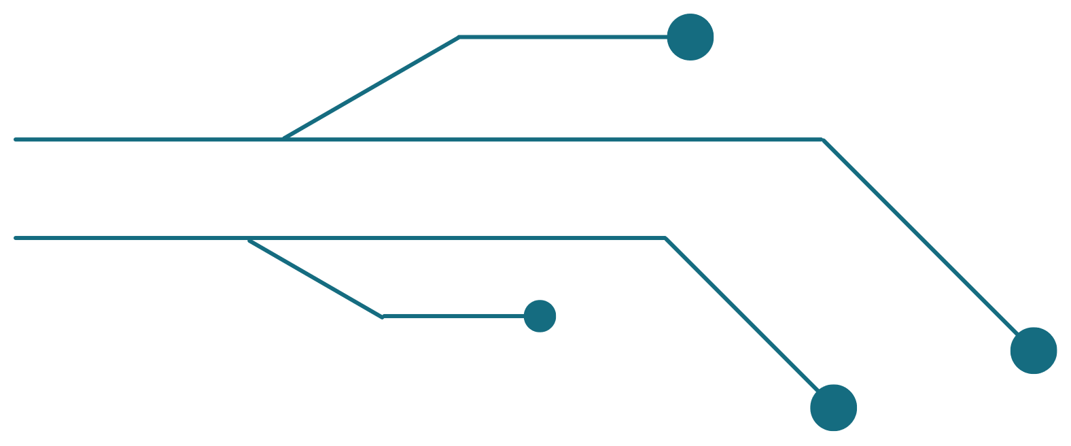
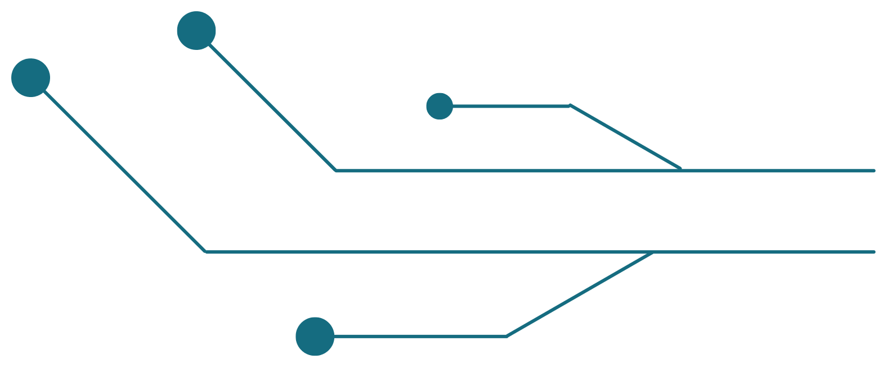

Intelligent Programming Companion
IPC

Slide 2
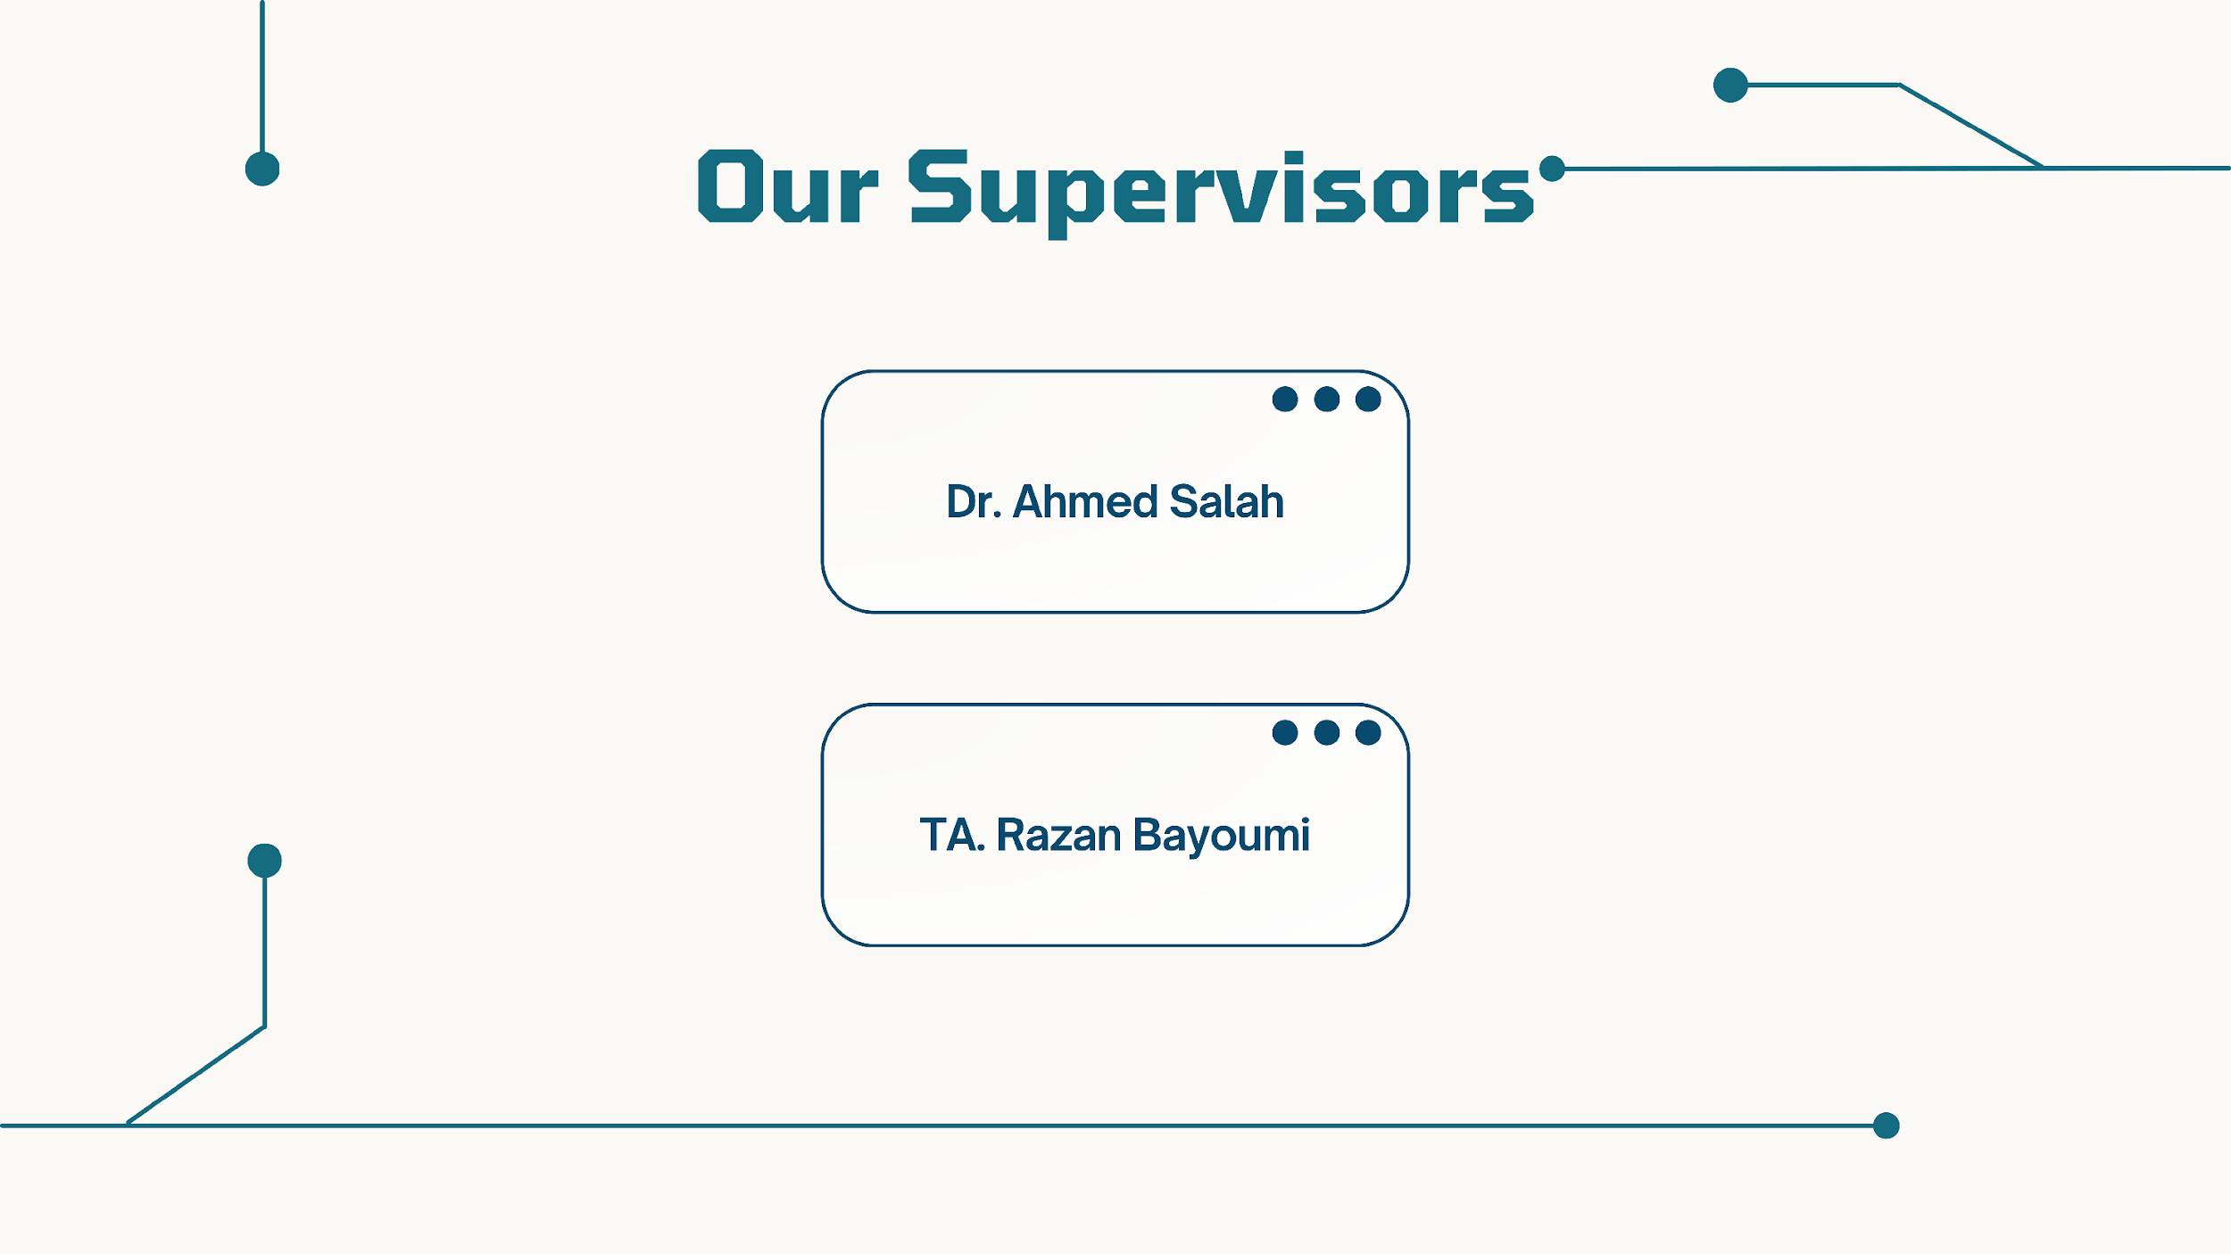
Our Supervisors

Slide 3
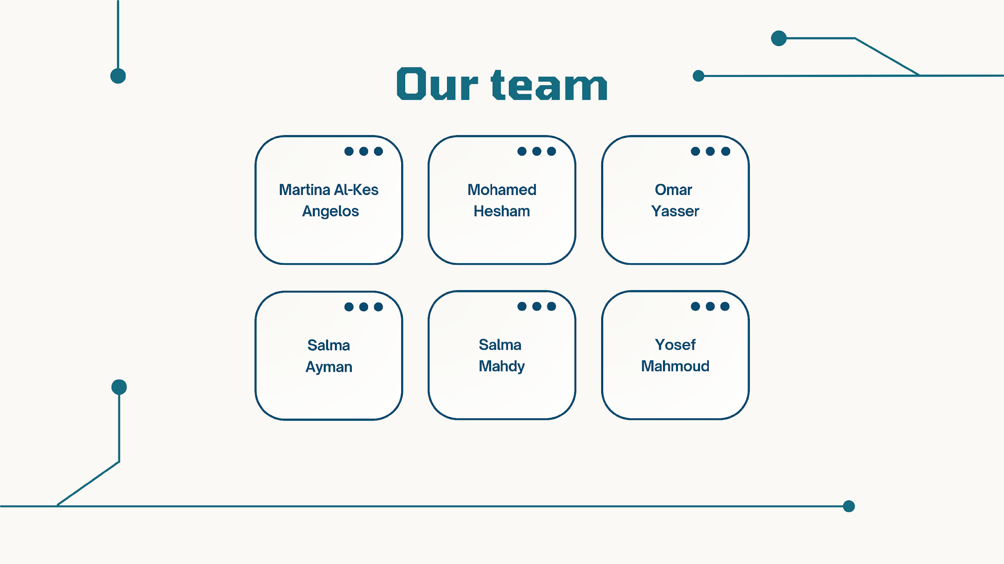
Our Team

Slide 4


Table Of Content
01
02
03
Introduction
Motivation
Objectives
04
System Architecture
05
06
Phases Description
Dataset
07
Experiment & Results
08
Demo & Conclusion
09
Future Work & References

Slide 5



01
Introduction

Slide 6
WHAT IS IPC ?
Your Gateway to Competitive Programming and Interview Preparation
Enhance the Competitive Programming Community
Simplify Interview and Contest Preparation

Slide 7
02
Motivation

Slide 8
Motivation
The motivation behind this project is to:
Foster seamless knowledge sharing and celebrate originality in a unified ecosystem.
Fill gaps in problem sharing, uniqueness validation, difficulty assessment, and AI-driven support.
Envision a future where programming enthusiasts thrive, setters innovate, and the community excels collaboratively.

Slide 9
03
Objectives

Slide 10

Objectives
Centralized Sharing Platform
Find Problem/Solution Similarity
Enhance Originality & Uniqueness
Streamline Difficulty
Assessment
Summarize Problem Statements
Develop a Standard Subproblem Solver

Slide 11
04
System Architecture

Slide 12
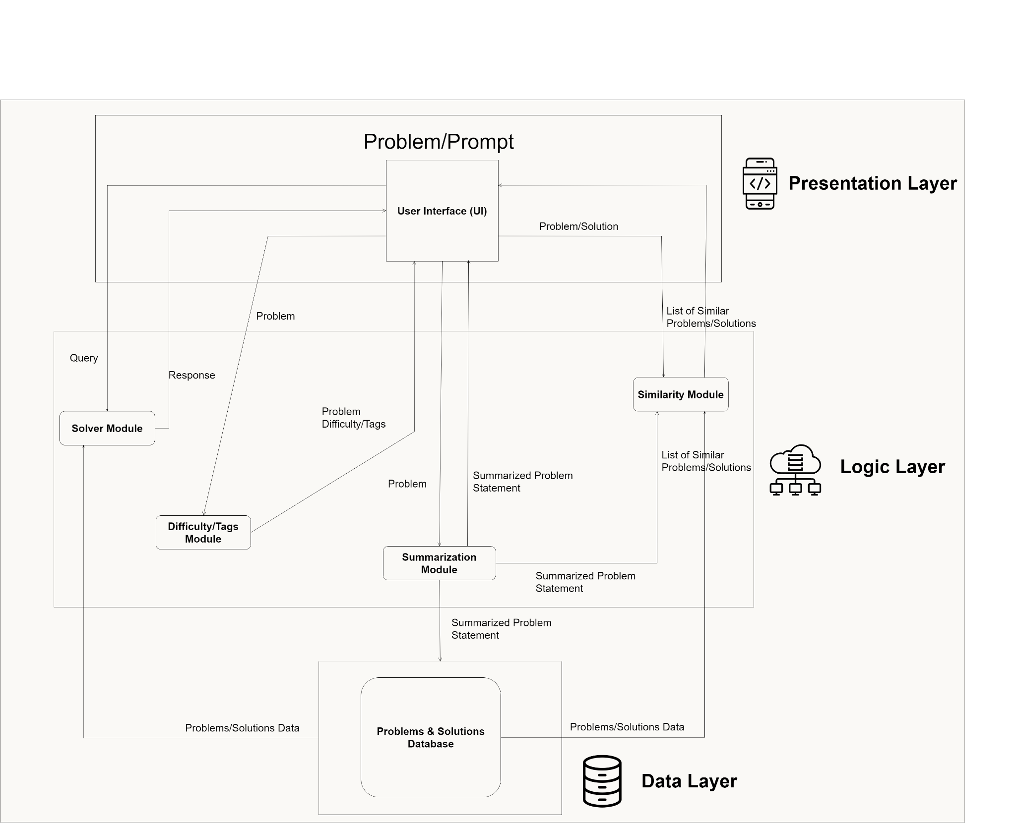
System Architecture

Slide 13
05
Dataset

Slide 14









Data Sources
Scraped dataset from various online judges and GitHub repos.
Total: 19,503 Problem - 1,700,412 Solution
Encountered rate limit constraints during web scraping for the dataset.
HackerEarth
UVA
Codeforces
AtCoder
CodeChef
GitHub
LeetCode

Slide 15
Dataset Structure
Two datasets:
Problems : Problem Link / Problem Text / Sample Input / Sample Output / Time Limit (s) / Memory Limit (mb) / Tags / Difficulty
Online Judge | AtCoder | CodeChef | CSES | Codeforces | HackerEarth | LeetCode | Uva | Yosupo
Number of Problems | 2,307 | 3,201 | 296 | 8,636 | 985 | 2,424 | 1,461 | 193

Slide 16
Dataset Structure
Two datasets:
Solutions: Problem Link / Submission Link / Problem Name / Source / Language/ Time / Memory / Solution
All solutions are in C++.
Online Judge | AtCoder | CodeChef | CSES | Codeforces | HackerEarth | LeetCode | Uva | Yosupo
Number of Solutions | 1,587,756 | 53,961 | 1,175 | 16,229 | 36,179 | 3,570 | 1,347 | 195

Slide 17
06
Phases Description

Slide 18
Finished Phases
Summarization Model
Problem Statements/Solution Source Codes Similarity Model
Difficulty/Tag Prediction Model
Solver Model

Slide 19
Summarization Model Phase

Slide 20
Statement Summarization Model
Providing summarization to a given problem statement.
Two approaches were explored:
Classical pre-LLM methods
Prompt engineering an LLM

Slide 21

Statement Summarization Model
Classical pre-LLM methods
Prior to the historic rise of LLMs, architectures
like BERT, and its family, which is based
on the transformer architecture, were the
standard for many NLP tasks.
Architectures used:
BERT
BART
T5
PEGASUS
Transformer's Architecture

Slide 22
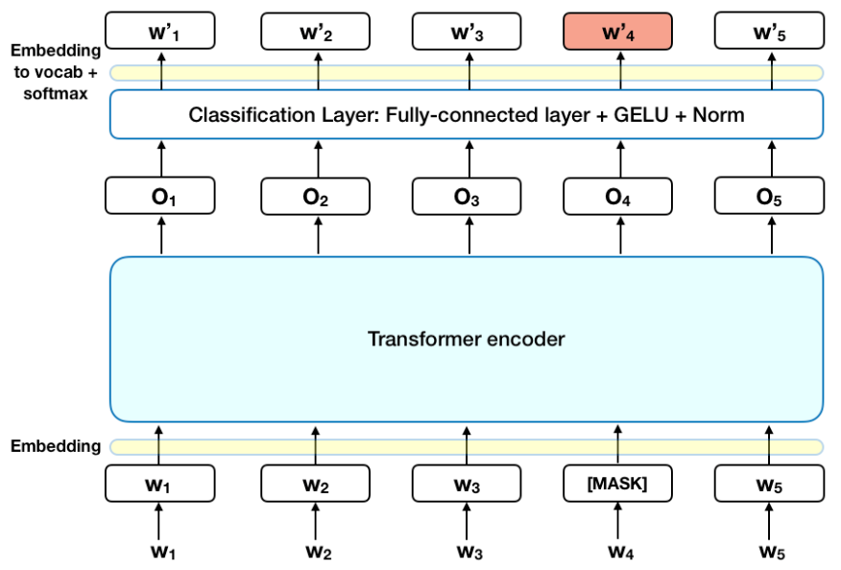
Statement Summarization Model
BERT is an encoder-only transformer model.
Consists of 3 main modules:
Embedding: Translates one-hot tokens to real-valued vectors, moving discrete tokens to a continuous space.
Encoder Stack: Applies bidirectional self-attention through multiple Transformer encoders on input vector sequence.
Un-embedding/Decoder: Reverts final representation vectors to one-hot tokens, predicting a probable token distribution.
Bert’s Architecture

Slide 23
Statement Summarization Model
Prompt engineering an LLM:
LLMs excel in downstream tasks like semantic analysis and summarization, even without specific training. Using LLMs and prompt engineering, this method creates detailed prompts to strip away legends and background stories, resulting in concise and clear statements.
LLMs used:
Gemma-7b
Mixtral-8x7b
Gemini 1.5 flash

Slide 24
07
Experiment & Results

Slide 25
Statement Summarization Model
Several metrics were used to assess the underlying LLM. The metrics used include:
General Ability (Chatbot Arena): This metric measures the overall performance and effectiveness of the model in a general conversational context.
Reasoning & Knowledge (MMLU): This metric evaluates the model’s ability to reason and utilize knowledge, as tested by the MMLU (Massive Multitask Language Understanding) benchmark.
Reasoning & Knowledge (MT Bench): This metric assesses the model’s reasoning and knowledge capabilities using the MT Bench.

Slide 26
Statement Summarization Model
Performance of different LLMs on different benchmarks:
The results are clear that Gemini 1.5 flash is best to its size
Model | General Ability (Chatbot Arena) [39] | Reasoning & Knowledge (MMLU)
Gemini 1.5 Flash [28] | 1231 | 79%
Mixtral 8x7B [29] | 1114 | 71%
Gemma-7b [30] | 1037 | 64%

Slide 27
Problem Statements / Solutions Source Codes Similarity Model Phase

Slide 28
Problem Statements/Solutions Source Codes Similarity Model
Objective
Finding similar problems/solutions to a given query.
Approaches
Clustering Approach
Nearest Vectors Approach (Used)
Dataset Used:
Used 27,516 solutions scraped from 8 different online judges
Used 18,325 problems scraped from 8 different online judges

Slide 29
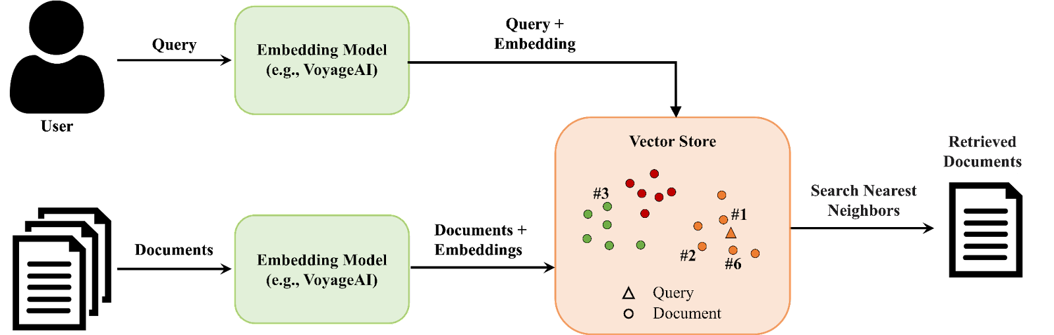
Problem Statement/Solution Source Code Similarity Model
Nearest Vectors Approach
Reference: https://blog.voyageai.com/2024/01/23/voyage-code-2-elevate-your-code-retrieval/

Slide 30
07
Experiment & Results

Slide 31
Problem Statement/Solution Source Code Similarity Model
Preprocessing
Remove #include directives
Remove using namespace
Remove comments
Remove all non-ASCII characters
Remove unused functions
Tokenize the source code
Attempted to
replace all macro directives
generate assembly code
However, those approaches led to an excessive number of tokens, exceeding the limitations of existing embedding models.

Slide 32
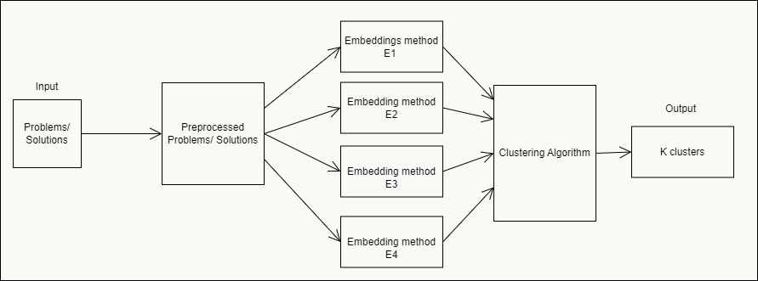
Problem Statement/Solution Source
Clustering Approach
The embeddings used for:
Solutions : voyage-code-2, all-mpnet-base-v2, word2vec, doc2vec, tf-idf
Tried using safe, InferCode embeddings, but encountered bugs.
Problems: all-mpnet-base-v2, bge-small-en-v1.5, all-MiniLM-L6-v2

Slide 33
Problem Statement/Solution Source Problem Similarity Model
Clustering Approach Results
For problem statements:
Embeddings Model | Clustering Algorithm | Number of Clusters | Silhouette Score
sentence-transformers/all-mpnet-base-v2 | K-means | 30 | 0.14809753
 | Agglomerative |  | 0.12610750
 | Spectral Clustering |  | 0.10872551
 | DBscan | - | -0.10904756
sentence-transformers/all-MiniLM-L6-v2 | K-means | 30 | 0.13519753
 | Agglomerative |  | 0.18610651
 | Spectral Clustering |  | 0.10872551
 | DBscan | - | -0.18904756

Slide 34
Problem Statement/Solution Source Code Similarity Model
Clustering Approach Results
For solutions source code:
Embeddings Model | Clustering Algorithm | Number of Clusters | Silhouette Score
TF-IDF | K-means | 23 | 0.52416289
 | Agglomerative |  | 0.50316228
 | Spectral Clustering |  | 0.40467228
 | DBscan | - | 0.42417239
Voyage-Code-2 | K-means | 23 | 0.4416289
 | Agglomerative |  | 0.4674223
 | Spectral Clustering |  | 0.4126262
 | DBscan | - | 0.3114283
sentence-transformers/all-mpnet-base-v2 | K-means | 23 | 0.13256446
 | Agglomerative |  | 0.113510504
 | Spectral Clustering |  | -0.040572744
 | DBscan | - | -0.06446284

Slide 35
Problem Statement/Solution Source Code Similarity Model
Nearest Vectors Approach
The embeddings used for:
Problem Statements: all-mpnet-base-v2, all-MiniLM-L6-v2, bge-small-en-v1.5
Solutions Source Codes: voyage-code-2, all-mpnet-base-v2
Attempted to use the following models for experimentation
jina-embeddings-v2-small-en: This model consists of 33 million parameters.
jina-embeddings-v2-base-en: This model consists of 137 million parameters.
Encountered memory constraints during the trials.
Unfortunately, these models couldn't be used due to the unavailability of sufficient memory resources.

Slide 36
Problem Statement/Solution Source
Nearest Vectors Approach was used due to the following metrics
Evaluation Metrics
Manual Assessment: Analyze 50 queries for both problem statements/solution source codes.
recall@k: Measure the hit rate of retrieving the gold standard document among top k retrieved documents.
Problem Statements: A hit is when, for a summarized problem statement, the original problem is retrieved.
Solutions Source Codes: A hit is when, for a solution for a particular problem, there exists another solution for that same problem in the retrieved solutions.
recall@k was measured for k = 1, 3, 5, 10.

Slide 37
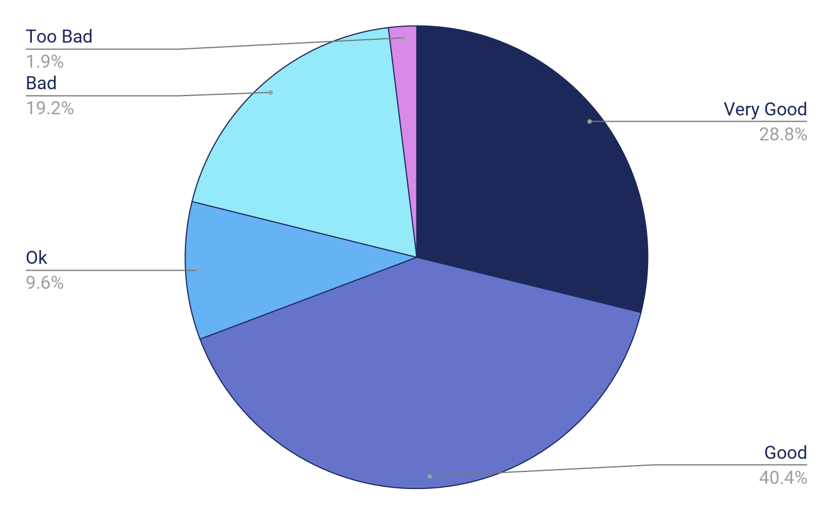
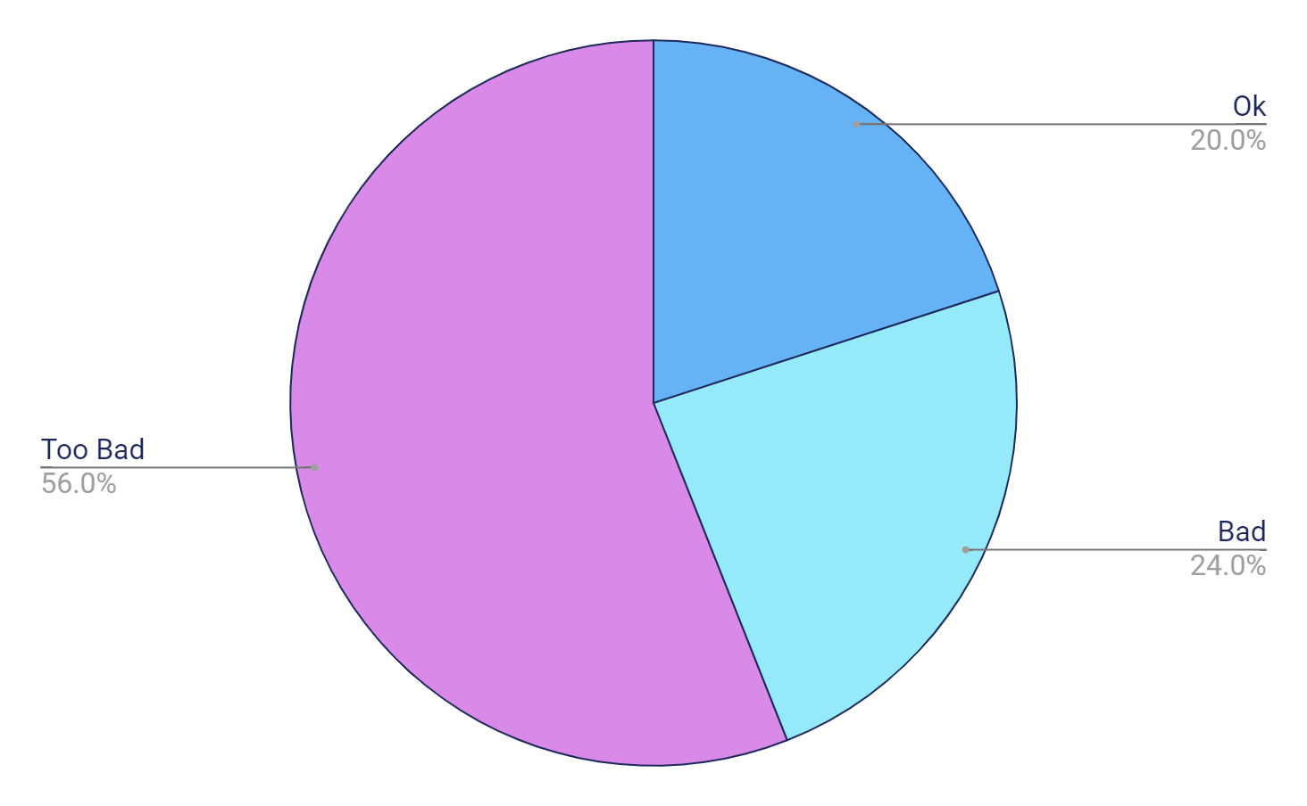
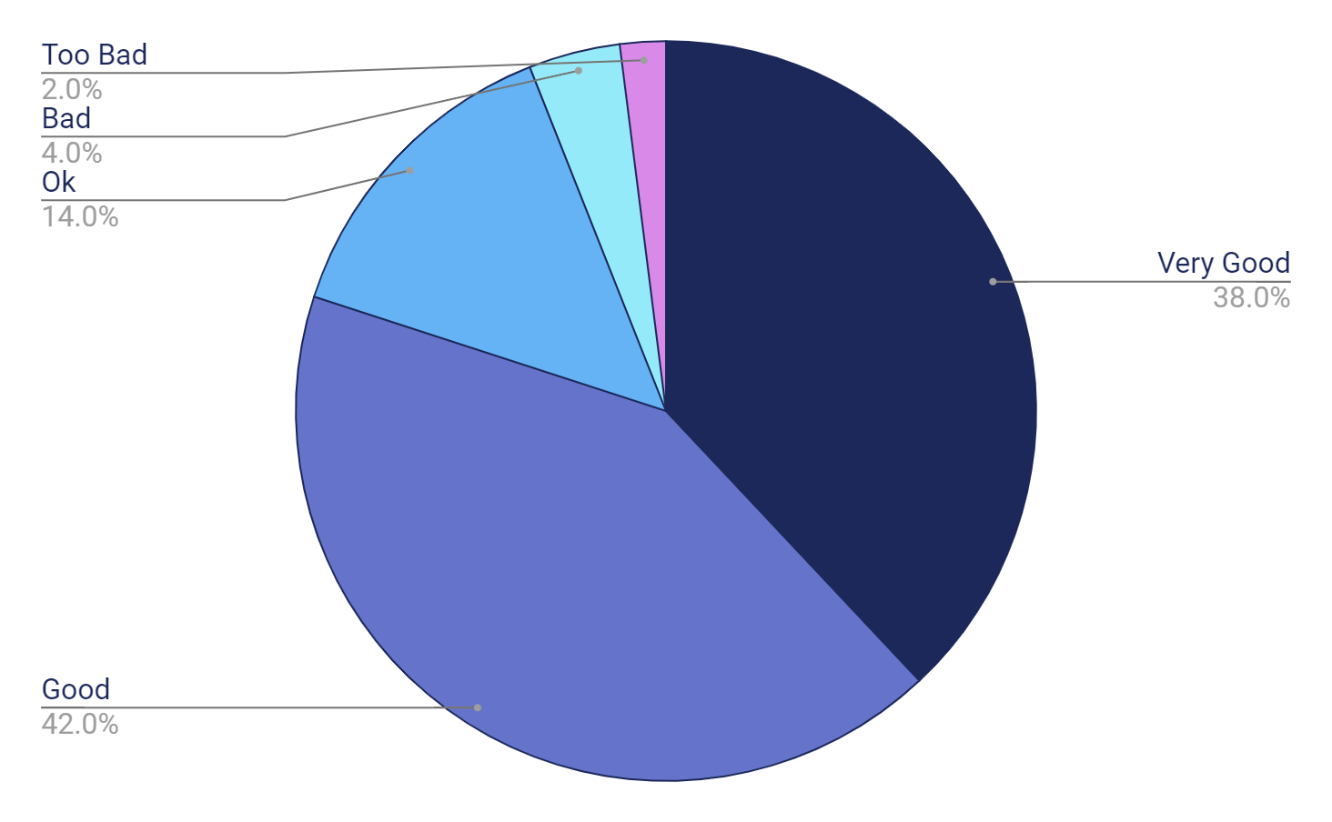
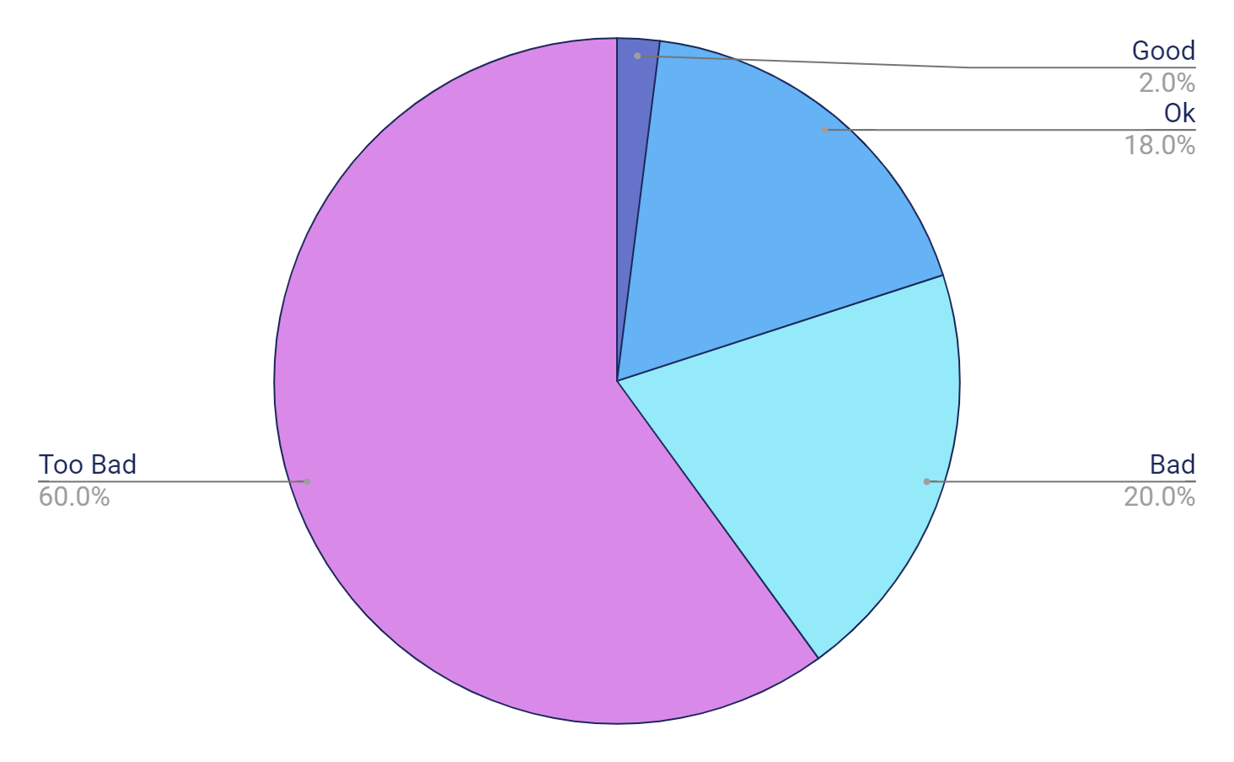
Problem Statement/Solution Source
Code Manual Assessment
Nearest Vectors Approach
Clustering Approach Results
Problem Statements
Solutions
Source Codes

Slide 38
Problem Statement/Solution Source Problems Similarity Model
Evaluation Metrics
recall@k, for problem statements
Embedding Model | all-mpnet-base-v2 | all-MiniLM-L6-v2 | bge-small-en-v1.5
recall@1 | 74% | 55.5% | 45.1%
recall@3 | 74.4% | 60.7% | 50.5%
recall@5 | 80.3% | 62% | 52.3%
recall@10 | 81% | 65.3% | 55.4%
Embedding Model | all-mpnet-base-v2 | all-MiniLM-L6-v2 | bge-small-en-v1.5
recall@1 | 90.5% | 82.5% | 75.1%
recall@3 | 94.5% | 88.5% | 80.5%
recall@5 | 96% | 90% | 85.3%
recall@10 | 97.5% | 93.5% | 90.2%
Clustering
Nearest Vector

Slide 39
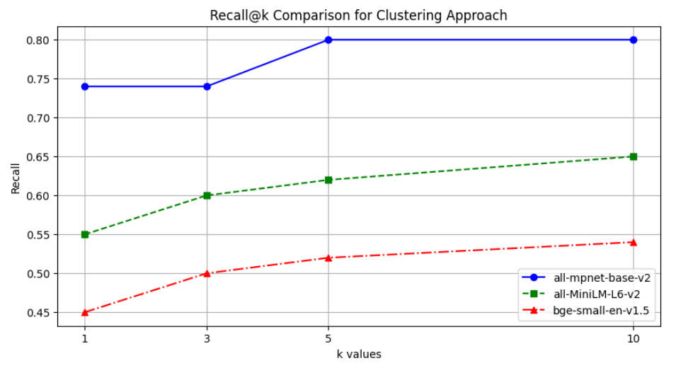
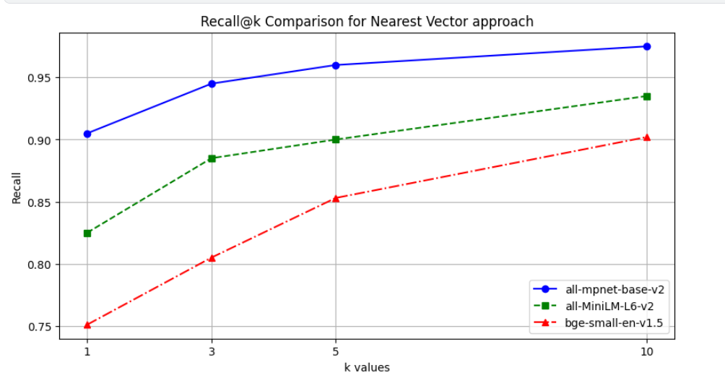
Problem Statement/Solution Source Problems Similarity Model
Evaluation Metrics
recall@k, for problem statements
Clustering
Nearest Vector

Slide 40
Problem Statement/Solution Source Problems Similarity Model
Evaluation Metrics
recall@k, for solutions source code
Embedding Model | voyage-code-2 | all-mpnet-base-v2 | tf-idf
recall@1 | 94% | 74% | 65.1%
recall@3 | 94.3% | 74.5% | 69.5%
recall@5 | 94.4% | 80.1% | 70.3%
recall@10 | 97% | 80.3% | 75.2%
Embedding Model | voyage-code-2 | all-mpnet-base-v2 | tf-idf
recall@1 | 99% | 82.5% | 75.1%
recall@3 | 99.2% | 88.5% | 80.5%
recall@5 | 99.2% | 90% | 85.3%
recall@10 | 99.6% | 93.5% | 90.2%
Clustering
Nearest Vector

Slide 41
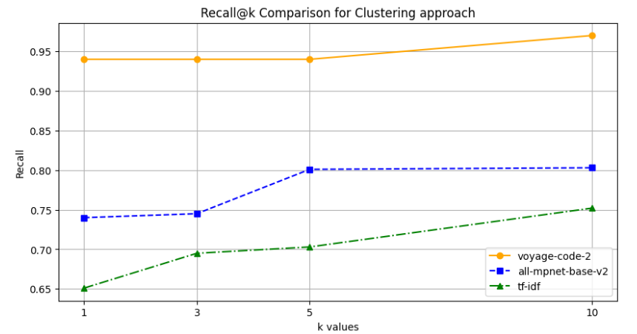
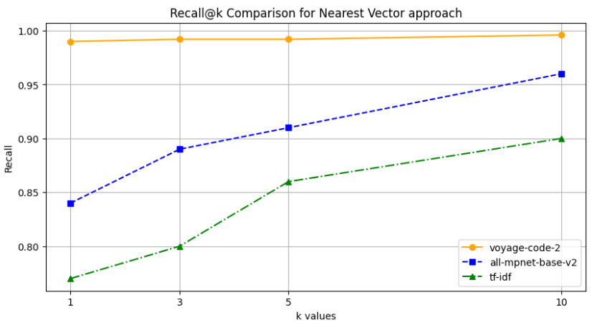
Problem Statement/Solution Source Problems Similarity Model
Evaluation Metrics
recall@k, for solutions source code
Clustering
Nearest Vector

Slide 42
Tags & Difficulty Prediction Model Phase

Slide 43
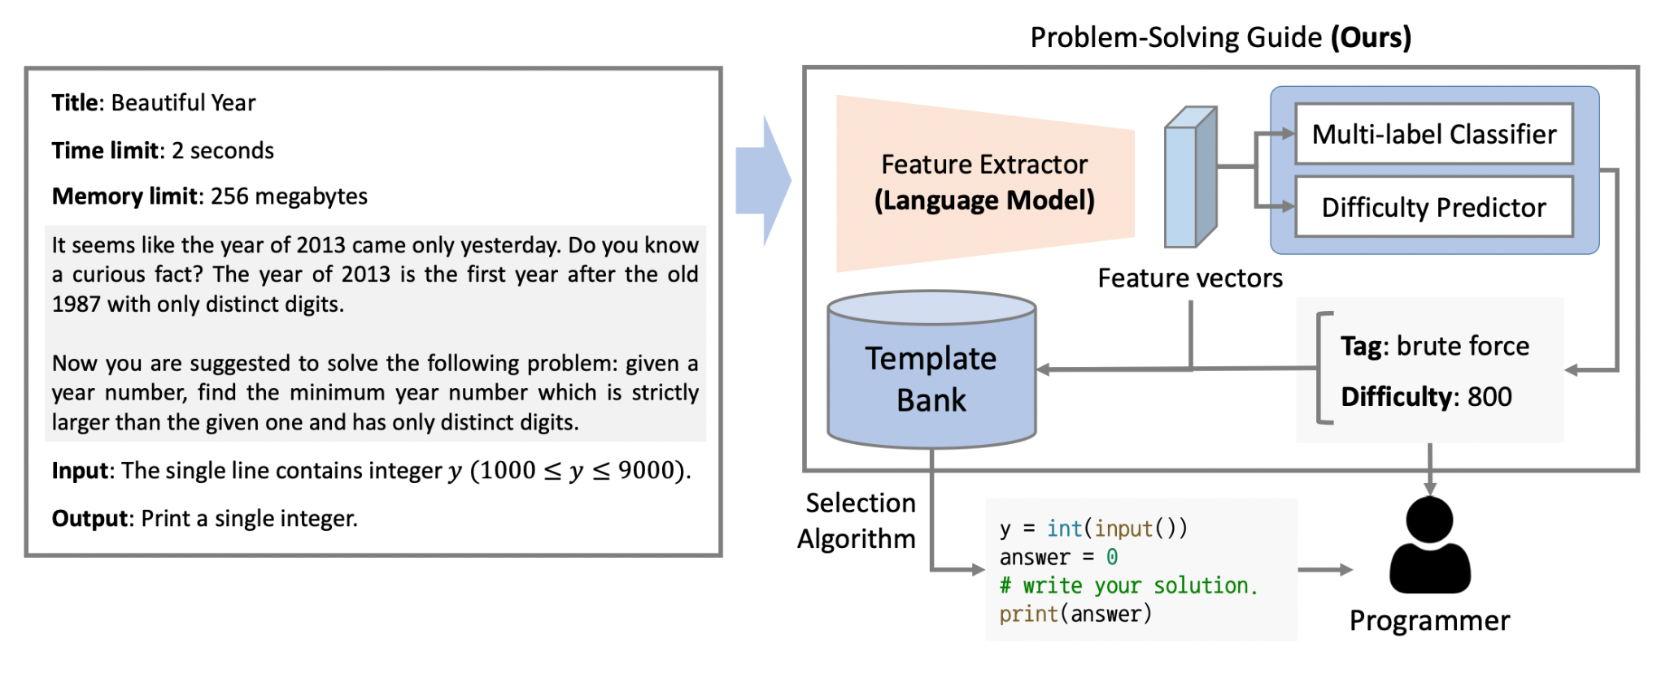
Tags & Difficulty Prediction Model
Objective
Predicting the tags & the difficulty of a given problem, using only its statement, which serves as a useful guidance to solving algorithm problems.
[2310.05791] Problem-Solving Guide: Predicting the Algorithm Tags and Difficulty for Competitive Programming Problems (arxiv.org)

Slide 44
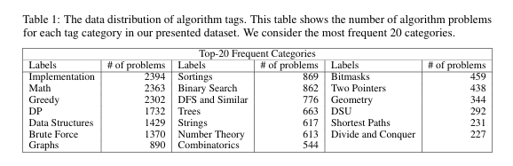
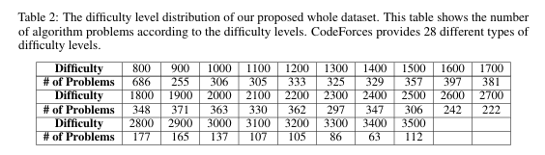
Tags & Difficulty Prediction Model
Approaches
Bidirectional Encoder Representations from Transformers (BERT)-based
Convolutional Neural Networks (CNN)-based
Dataset Used:
Used 8,636 problems scraped from codeforces online judge
[2310.05791] Problem-Solving Guide: Predicting the Algorithm Tags and Difficulty for Competitive Programming Problems (arxiv.org)

Slide 45
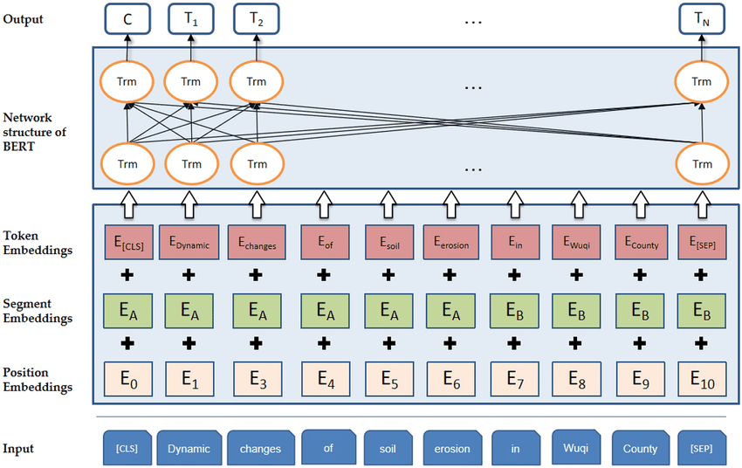
Tags & Difficulty Prediction Model
Bidirectional Encoder Representations from Transformers (BERT)
Transformers-based models, such as BERT, have been one of the most successful deep learning models for NLP. Unfortunately, one of their core limitations is the quadratic dependency (mainly in terms of memory) on the sequence length due to their full attention mechanism.
[1810.04805] BERT: Pre-training of Deep Bidirectional Transformers for Language Understanding (arxiv.org)

Slide 46
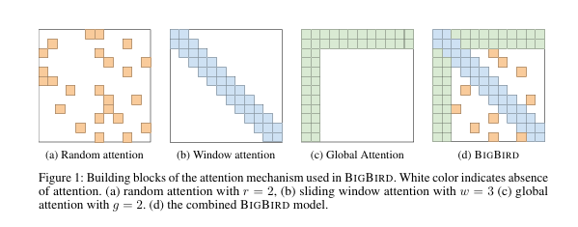
Tags & Difficulty Prediction Model
BigBird BERT-based Architecture
To remedy the quadratic dependency, BigBird was proposed. A sparse attention mechanism that reduces this quadratic dependency to linear.
[2007.14062] Big Bird: Transformers for Longer Sequences (arxiv.org)

Slide 47
Tags & Difficulty Prediction Model
Model Preprocessing
Substitute exponential notation. 10^6 -> 1000000
Insert spaces between the dollar signs. $$$n$$$ -> $$$ n $$$
Convert to lowercase. This is an interactive task. -> this is an interactive task.
Calculate the expression. 2 \cdot 100000 -> 200000
Remove stopwords using the nltk library.
Lemmatize using the nltk library.
[2310.05791] Problem-Solving Guide: Predicting the Algorithm Tags and Difficulty for Competitive Programming Problems (arxiv.org)

Slide 48
07
Experiment & Results

Slide 49
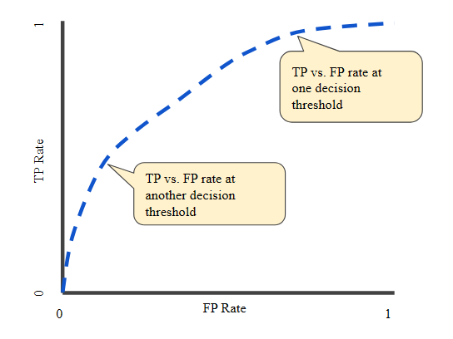
Tags & Difficulty Prediction Model
Evaluation Metric: ROC Curve and AUC
An ROC curve (receiver operating characteristic curve) is a graph showing the performance of a classification model at all classification thresholds.
Classification: ROC Curve and AUC | Machine Learning | Google for Developers

Slide 50
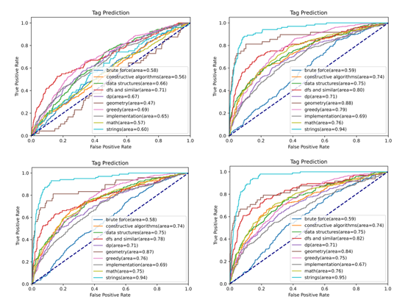
Tags & Difficulty Prediction Model
The ROC Curves of Various Model Variations
The top-left figure shows the ROC curve of our PSG model trained with λ = 1.
The top-right figure represents the ROC curve of our PSG model trained with λ = 10.
The bottom-left figure shows the ROC curve of our PSG model trained with λ = 100.
The bottom-right figure shows the ROC curve of the single-task BigBird model to solve only the second task T2.
[2310.05791] Problem-Solving Guide: Predicting the Algorithm Tags and Difficulty for Competitive Programming Problems (arxiv.org)

Slide 51
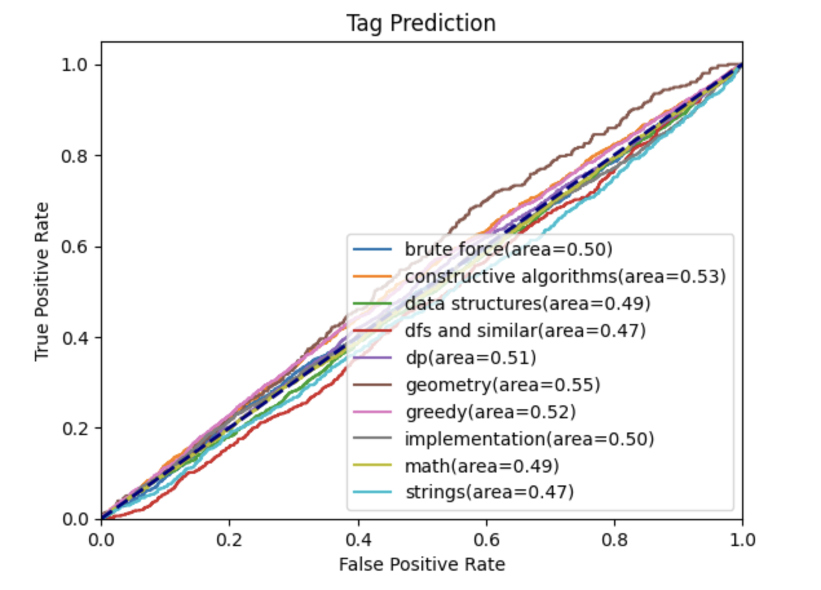
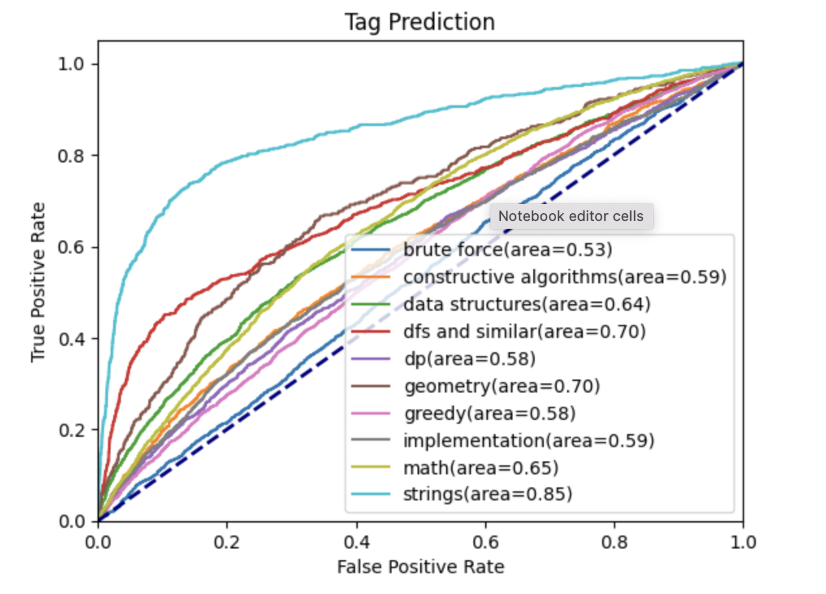
Tags & Difficulty Prediction Model
Model Fine-tuning
This figures shows the ROC curve of the model trained with λ = 10 before vs after fine-tuning.

Slide 52
Tags & Difficulty Prediction Model
Model Fine-tuning
This figures shows the ROC AOC of the model trained with λ = 10 before vs after fine-tuning.
Tag | ROC AUC Score
Brute Force | 0.4988761649662423
Constructive Algorithms | 0.5254671800232651
Data Structures | 0.48728644926505377
DFS & Similar | 0.4662761353212205
DP | 0.5058108047709923
Geometry | 0.5502973779899359
Greedy | 0.524842831181587
Implementation | 0.49518521922721404
Math | 0.4942442681391869
Strings | 0.465118024759793
Overall | 0.501340445564449
Tag | ROC AUC Score
Brute Force | 0.525823928331377
Constructive Algorithms | 0.5928472660238192
Data Structures | 0.644335730322832
DFS & Similar | 0.6987255162564759
DP | 0.5779329162331409
Geometry | 0.6961174275062614
Greedy | 0.5752724768398076
Implementation | 0.585553736568545
Math | 0.651829652894629
Strings | 0.8505330705968542
Overall | 0.6398971721573743

Slide 53
Solver Model Phase

Slide 54
Solver Model
Objective
Strong code generation capabilities .
Supporting long context understanding and generation.
Approach
Code-Specific version of Qwen1.5. It is a transformer-based decoder-only language model pre-trained on a large amount of data of codes.
RAG (Retrieval Augmented Generation) : AI framework for improving the quality of LLM-generated responses by retrieving facts from an external knowledge base to ground large language models (LLMs) on the most accurate, up-to-date information and to give users insight into LLMs' generative process.
Dataset Used
Used 3,154 problems and solutions scraped from CSES, LeetCode, uva and yosupo online judges.
[28 Sep 2023] QWEN TECHNICAL REPORT

Slide 55
Solver Model
Used LLMs :
Llama Architecture
It is based on the transformer architecture with various improvements that were subsequently proposed. The main difference with the original architecture are listed below:
RMSNorm normalizing function(Root Mean Square Normalization)
is used to improve the training stability, by normalizing the input of each transformer sub-layer, instead of normalizing the output.
The ReLU non-linearity is replaced by the SwiGLU(Switched Gated Linear Unit) activation function f(x)=x⋅σ(x) combines the linear transformation with a sigmoid gate to improve performance.
Absolute positional embeddings are removed and instead rotary positional embeddings (RoPE) are added at each layer of the network.
introduces learnable parameters that encode position-dependent rotations into the model
[27Feb 2023] LLaMA

Slide 56
Solver Model
Used LLMs :
CodeQwen Architecture
Qwen-7B is built with architecture similar to LLaMA.
The following are the main differences from the standard transformer:
1) using untied embedding: separate embedding matrices are used for input and output tokens.
2) using rotary positional embedding.
3) no biases except for QKV(Query, Key, and Value) in attention.
4) RMSNorm instead of LayerNorm.
5) SwiGLU instead of ReLU.
6) adopting flash attention to accelerate training: by approximating the full attention matrix with a low-rank decomposition.
[28 Sep 2023] QWEN TECHNICAL REPORT

Slide 57
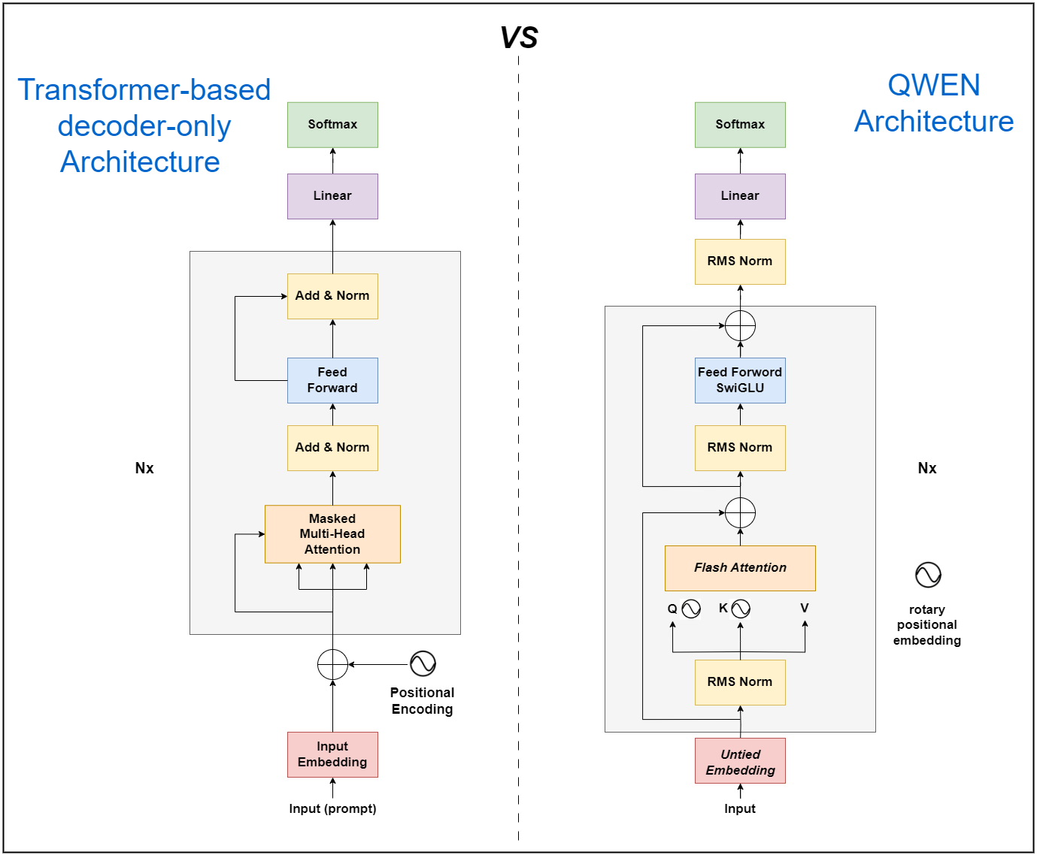
Solver Model
LLama architecture

Slide 58
Solver Model
 | Llama 2 -7B | CodeQwen 1.5 -7B
Number of Layers | 32 | 32
Attention Heads | 32 | 32
Embedding Dimension | 4096 | 4096
Sequence Length | 2048 | 2048
[28 Sep 2023] QWEN TECHNICAL REPORT

Slide 59
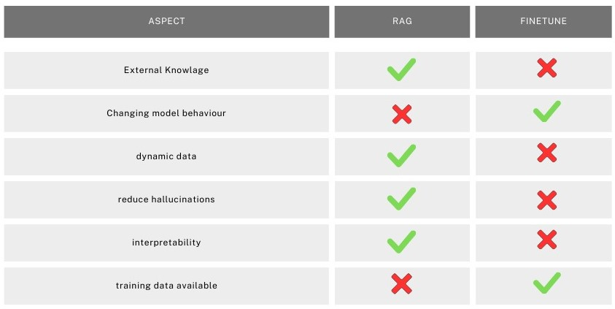
Solver Model
RAG vs Finetuning

Slide 60
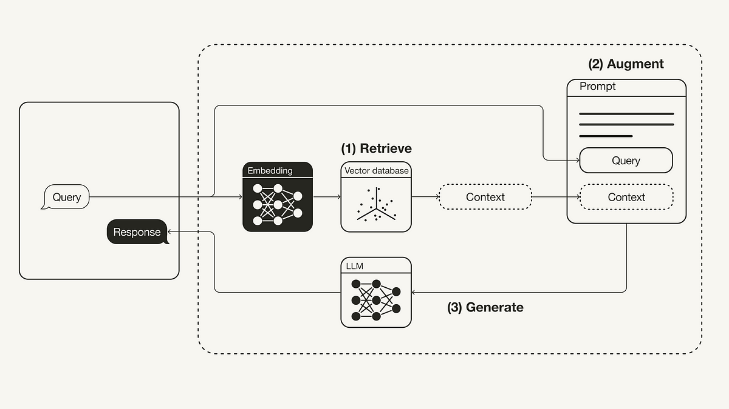
Solver Model
RAG Architecture

Slide 61
07
Experiment & Results

Slide 62
Solver Model Experiment & Results
EvalPlus (HumanEval, MBPP”Model-based Policy Optimization”)
Model | Size | HumanEval 0-shot | HumanEval+ 0-shot | MBPP 0-shot | MBPP+ 0-shot | MBPP 3-shot
CodeLlama-Base [32] | 7B | 33.5 | 25.6 | 52.1 | 41.6 | 38.6
StarCoder2 [33] | 7B | 35.4 | 29.9 | 54.4 | 45.6 | 51.0
DeepSeek-Coder-Base [34] | 6.7B | 47.6 | 39.6 | 70.2 | 56.6 | 60.6
CodeQwen1.5-Chat [35] | 7B | 83.5 | 78.7 | 77.7 | 67.2 | 70.6

Slide 63
Solver Model Experiment & Results
LiveCodeBench: continuously collects new problems over time from contests across 3 competition platforms LeetCode, AtCoder, and CodeForces. Here is our evaluation script.
Model | Size | Code Generation All Time Pass@1 | Code Generation 2023/9/1 ~ 2024/4/1 Pass@1
CodeLlama-Base [32] | 7B | 6.5 | 7.6
StarCoder2 [33] | 7B | 11.3 | 12.7
DeepSeek-Coder-Base [34] | 6.7B | 19.1 | 13.7
CodeQwen1.5 [35] | 7B | 21.8 | 19.3

Slide 64
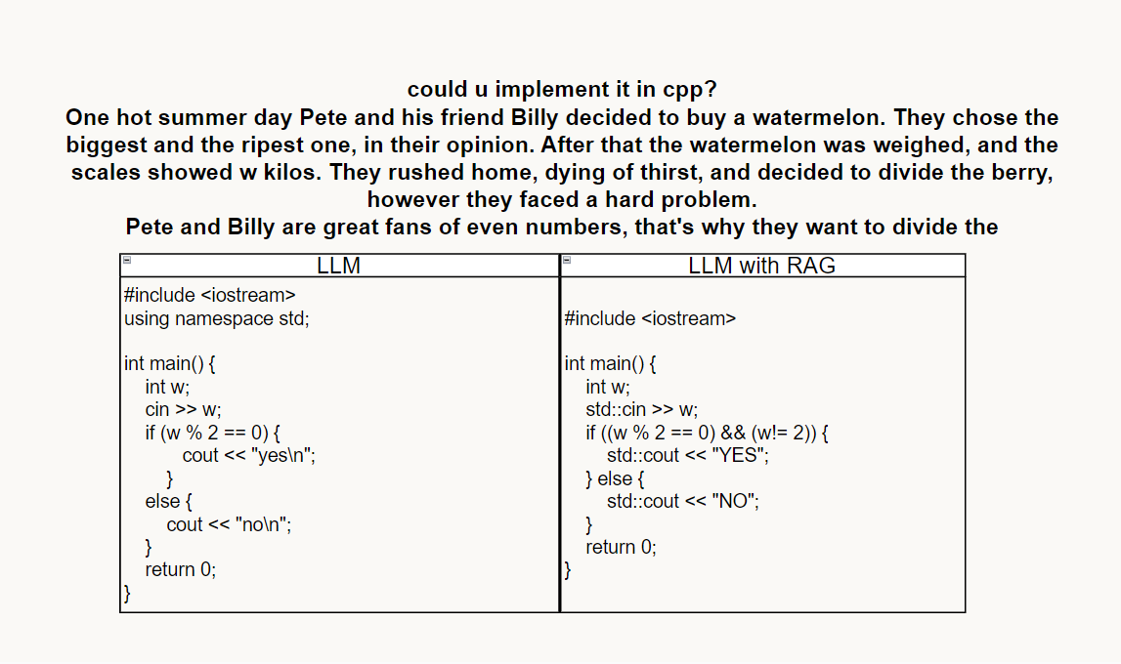
Solver Model Experiment & Results

Slide 65
08
Demo & Conclusion

Slide 66
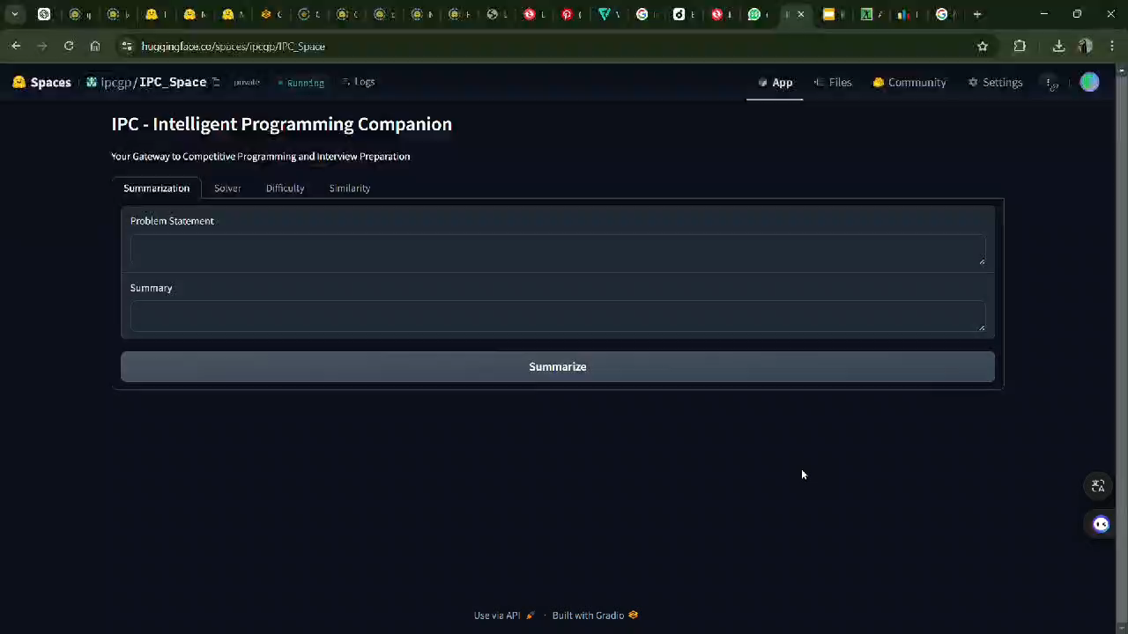
Demo

Slide 67
Conclusion
Significant challenges in competitive programming and interview preparation were addressed through the development of a centralized platform.
The implemented modules—Summarization, Similarity, Difficulty/Tags Prediction, and Solver—have demonstrated strong performance metrics. The Similarity Module achieved a remarkable 99.6% recall@10, and the Difficulty/Tags Prediction Module showed robust performance with a ROC AUC score of 76.37%.
By addressing issues such as problem repetition, inconsistent difficulty assessments, platform fragmentation, and ambiguous problem descriptions, our platform aims to create a more cohesive and supportive environment for competitive programmers and interview candidates.

Slide 68
09
Future Work & References

Slide 69
Future Work
Enhance AI models for improved accuracy and responsiveness
Expand dataset and include more diversity for better predictions
Implement user feedback integration for optimizing platform functions
Foster collaborative problem-solving through community features
Pursue partnerships with educational institutions for curriculum integration

Slide 70

References
Stoica, A., Băbiceanu, D., Rebedea, T., & Mihăescu, M.(2023). Unsupervised Voting for Detecting the Algorithmic Solving Strategy in Competitive Programming Solutions. Research Article https://doi.org/10.21203/rs.3.rs-2834777/v1
Athavale, V., Naik, A., Vanjape, R., & Shrivastava, M. (2019, April 4). Predicting algorithm classes for programming word problems. arXiv.org. https://doi.org/10.48550/arXiv.1903.00830
Crawshaw, M. (2020, September 10). Multi-task learning with deep neural networks: A survey. arXiv.org. https://doi.org/10.48550/arXiv.2009.09796
Sebastian Ruder. An overview of multi-task learning in deep neural networks. arXiv preprint arXiv:1706.05098, 2017.
Gao, Y., Xiong, Y., Gao, X., Jia, K., Pan, J., Bi, Y., Dai, Y., Sun, J., Wang, M., & Wang, H. (2024, March 27). Retrieval-augmented generation for large language models: A survey. arXiv.org. https://arxiv.org/abs/2312.10997
Notes:
Technique-Based Problem Clustering

Slide 71
References
Touvron, H., Lavril, T., Izacard, G., Martinet, X., Lachaux, M.-A., Lacroix, T., Rozière, B., Goyal, N., Hambro, E., Azhar, F., Rodriguez, A., Joulin, A., Grave, E., & Lample, G. (2023, February 27). Llama: Open and efficient foundation language models. arXiv.org. https://arxiv.org/abs/2302.13971v1
Bai, J., Bai, S., Chu, Y., Cui, Z., Dang, K., Deng, X., Fan, Y., Ge, W., Han, Y., Huang, F., Hui, B., Ji, L., Li, M., Lin, J., Lin, R., Liu, D., Liu, G., Lu, C., Lu, K., … Zhu, T. (2023, September 28). Qwen Technical Report. arXiv.org. https://arxiv.org/abs/2309.16609
Lomshakov, V., Kovalchuk, S., Omelchenko, M., Nikolenko, S., Aliev, A. (2023). Fine-Tuning Large Language Models for Answering Programming Questions with Code Snippets. In: Mikyška, J., de Mulatier, C., Paszynski, M., Krzhizhanovskaya, V.V., Dongarra, J.J., Sloot, P.M. (eds) Computational Science – ICCS 2023. ICCS 2023. Lecture Notes in Computer Science, vol 14074. Springer, Cham. https://doi.org/10.1007/978-3-031-36021-3_15
Zelikman, E., Huang, Q., Poesia, G., Goodman, N., & Haber, N. (2023). Parsel: Algorithmic Reasoning with Language Models by Composing Decompositions.
Notes:
Technique-Based Problem Clustering

Slide 72
References
Vaswani, A., Shazeer, N., Parmar, N., Uszkoreit, J., Jones, L., Gomez, A., Kaiser, Ł., & Polosukhin, I. (2023). Attention Is All You Need.
Heffernan, K., & Teufel, S. (2022). Problem-solving Recognition in Scientific Text. 13th Conference on Language Resources and Evaluation (LREC 2022).
Kim, J., Cho, E., Kim, D., & Na, D. (2023, October 9). Problem-solving guide: Predicting the algorithm tags and difficulty for competitive programming problems. arXiv.org. https://arxiv.org/abs/2310.05791
Google. (n.d.). Classification: Roc curve and AUC | machine learning | google for developers. Google. https://developers.google.com/machine-learning/crash-course/classification/roc-and-auc
Zaheer, M., Guruganesh, G., Dubey, A., Ainslie, J., Alberti, C., Ontanon, S., Pham, P., Ravula, A., Wang, Q., Yang, L., & Ahmed, A. (2021, January 8). Big bird: Transformers for longer sequences. arXiv.org. https://arxiv.org/abs/2007.14062
Devlin, J., Chang, M.-W., Lee, K., & Toutanova, K. (2019, May 24). Bert: Pre-training of deep bidirectional Transformers for language understanding. arXiv.org. https://arxiv.org/abs/1810.04805
W. Looi, Analysis of code submissions in competitive programming contests.
Notes:
Technique-Based Problem Clustering

Slide 73
References
J. Austin, A. Odena, M. Nye, M. Bosma, H. Michalewski, D. Dohan, E. Jiang, C. Cai, M. Terry, Q. Le, et al., Program synthesis with large language models, arXiv preprint arXiv:2108.07732.
Norouzi, S., Cao, Y.: Semantic parsing with less prior and more monolingual data. CoRR abs/2101.00259 (2021). https://arxiv.org/abs/2101.00259
Beau, N., Crabbé, B.: The impact of lexical and grammatical processing on generating code from natural language. In: Findings of the Association for Computational Linguistics: ACL 2022, pp. 2204–2214. Association for Computational Linguistics, Dublin, Ireland (2022). https://doi.org/10.18653/v1/2022.findings-acl.173
Soliman, A.S., Hadhoud, M.M., Shaheen, S.I.: MarianCG: a code generation transformer model inspired by machine translation. J. Eng. Appl. Sci. 69(1), 1–23 (2022)
Shen, B., Zhang, J., Chen, T., Zan, D., Geng, B., Fu, A., Zeng, M., Yu, A., Ji, J., Zhao, J., Guo, Y., & Wang, Q. (2023, July 27). Pangu-Coder2: Boosting large language models for code with ranking feedback. arXiv.org. https://arxiv.org/abs/2307.14936
Notes:
Technique-Based Problem Clustering

Slide 74
References
Li, Y., Choi, D., Chung, J., Kushman, N., Schrittwieser, J., Leblond, R., Eccles, T., Keeling, J., Gimeno, F., Lago, A. D., Hubert, T., Choy, P., d’Autume, C. de M., Babuschkin, I., Chen, X., Huang, P.-S., Welbl, J., Gowal, S., Cherepanov, A., … Vinyals, O. (2022, February 8). Competition-level code generation with AlphaCode. arXiv.org. https://arxiv.org/abs/2203.07814
See, A., Liu, P. J., & Manning, C. D. (2017, April 25). Get to the point: Summarization with pointer-generator networks. arXiv.org. https://doi.org/10.48550/arXiv.1704.04368
Zhang, J., Zhao, Y., Saleh, M., & Liu, P. J. (2020). PEGASUS: Pre-training with extracted gap-sentences for abstractive summarization. In Proceedings of the 37th International Conference on Machine Learning (Vol. 119). https://proceedings.mlr.press/v119/zhang20ae/zhang20ae.pdf
Reimers, N., & Gurevych, I. (2019, August 27). Sentence-BERT: Sentence embeddings using Siamese BERT-networks. arXiv.org. https://doi.org/10.48550/arXiv.1908.10084
S. Subramanian, A. Arun Kumar, M. Muthu Nagappan, and R. Suresh, "Classification and Recommendation of Competitive Programming Problems Using CNN," in Smart Secure Systems – IoT and Analytics Perspective, December 2018, pp. 262-272. DOI: 10.1007/978-981-10-7635-0_20.
Notes:
Technique-Based Problem Clustering

Slide 75
References
Rahman, M. M., Das, B. C., Biswas, A. A., & Anwar, M. M. (2023). Predicting participants’ performance in programming contests using deep learning techniques. arXiv.org. Retrieved from https://arxiv.org/pdf/2302.05602
Team, G., Georgiev, P., Lei, V. I., Burnell, R., Bai, L., Gulati, A., Tanzer, G., Vincent, D., Pan, Z., Wang, S., Mariooryad, S., Ding, Y., Geng, X., Alcober, F., Frostig, R., Omernick, M., Walker, L., Paduraru, C., Sorokin, C., … Vinyals, O. (2024a, June 14). Gemini 1.5: Unlocking multimodal understanding across millions of tokens of context. arXiv.org. https://arxiv.org/abs/2403.05530
Jiang, A. Q., Sablayrolles, A., Roux, A., Mensch, A., Savary, B., Bamford, C., Chaplot, D. S., Casas, D. de las, Hanna, E. B., Bressand, F., Lengyel, G., Bour, G., Lample, G., Lavaud, L. R., Saulnier, L., Lachaux, M.-A., Stock, P., Subramanian, S., Yang, S., … Sayed, W. E. (2024, January 8). Mixtral of Experts. arXiv.org. https://arxiv.org/abs/2401.04088
Notes:
Technique-Based Problem Clustering

Slide 76
References
Team, Gemma, Mesnard, T., Hardin, C., Dadashi, R., Bhupatiraju, S., Pathak, S., Sifre, L., Rivière, M., Kale, M. S., Love, J., Tafti, P., Hussenot, L., Sessa, P. G., Chowdhery, A., Roberts, A., Barua, A., Botev, A., Castro-Ros, A., Slone, A., … Kenealy, K. (2024a, April 16). Gemma: Open models based on Gemini Research and Technology. arXiv.org. https://arxiv.org/abs/2403.08295
Judging LLM-as-a-judge with MT-bench and Chatbot Arena. (n.d.). https://arxiv.org/pdf/2306.05685
Rozière, B., Gehring, J., Gloeckle, F., Sootla, S., Gat, I., Tan, X. E., Adi, Y., Liu, J., Sauvestre, R., Remez, T., Rapin, J., Kozhevnikov, A., Evtimov, I., Bitton, J., Bhatt, M., Ferrer, C. C., Grattafiori, A., Xiong, W., Défossez, A., … Synnaeve, G. (2024, January 31). Code llama: Open foundation models for code. arXiv.org. https://arxiv.org/abs/2308.12950
Li, R., Allal, L. B., Zi, Y., Muennighoff, N., Kocetkov, D., Mou, C., Marone, M., Akiki, C., Li, J., Chim, J., Liu, Q., Zheltonozhskii, E., Zhuo, T. Y., Wang, T., Dehaene, O., Davaadorj, M., Lamy-Poirier, J., Monteiro, J., Shliazhko, O., … de Vries, H. (2023, December 13). Starcoder: May the source be with you!. arXiv.org. https://arxiv.org/abs/2305.06161
Notes:
Technique-Based Problem Clustering

Slide 77
References
Deepseek-ai/deepseek-coder-6.7b-base · hugging face. deepseek-ai/deepseek-coder-6.7b-base · Hugging Face. (n.d.). https://huggingface.co/deepseek-ai/deepseek-coder-6.7b-base
QwenLM. (n.d.). QWENLM/Codeqwen1.5: Codeqwen1.5 is the code version of Qwen, the large language model series developed by Qwen team, Alibaba Cloud. GitHub. https://github.com/QwenLM/CodeQwen1.5
Vinayak Athavale, Aayush Naik, Rajas Vanjape, and Manish Shrivastava. Predicting algorithm classes for programming word problems. In Conference on Empirical Methods in Natural Language Processing, 2019
Sebastian Ruder. An overview of multi-task learning in deep neural networks. arXiv preprint arXiv:1706.05098, 2017.
Michael Crawshaw. Multi-task learning with deep neural networks: A survey. arXiv preprint arXiv:2009.09796, 2020.
Chatbot Arena: Find the best chatbot builder. Chatbot Arena: Find the Best Chatbot Builder. (n.d.). https://chatbotarena.com/
Notes:
Technique-Based Problem Clustering

Slide 78
Thank You
Any Questions?

